Slide 1

Vel Tech Rangarajan Dr. Sagunthala R&D Institute of Science and Technology
School of Computing
Department of Computer Science and Engineering
10211CS224 / FULL STACK APPLICATION DEVELOPMENT (JAVA)
PROJECT REVIEW : MILESTONE PROJECT – 1
Date: DD-MM-YYYY
End-to-End Event Lifecycle & Ticketing Platform
SDG: SDG 9 – Industry, Innovation, and Infrastructure
Presented By:
Malepati Prem Kumar Reddy – VTU26418 – 23UECS1122.
Courses Handling Faculty:
Dr./Mr./Mrs. Name - Designation

Slide 2
INTRODUCTION
In the modern digital world, event booking systems are essential for efficient management and user convenience. Many existing systems still rely on manual processes, which leads to inefficiency and poor user experience. This project, Eventify, is a web-based platform that allows users to explore, view, and book events online. It provides an integrated system for event discovery and booking with real-time data. The system also includes an admin panel to manage events efficiently. It reduces manual work and improves accuracy. This project is highly relevant for real-world applications like ticket booking platforms. It ensures centralized and automated event management.
1
2
3
4
5
6
7
8
9

Slide 3
PROBLEM STATEMENT
In the modern digital world, event booking systems are essential for efficient management and user convenience. Many existing systems still rely on manual processes, which leads to inefficiency and poor user experience. This project, Eventify, is a web-based platform that allows users to explore, view, and book events online. It provides an integrated system for event discovery and booking with real-time data. The system also includes an admin panel to manage events efficiently. It reduces manual work and improves accuracy. This project is highly relevant for real-world applications like ticket booking platforms. It ensures centralized and automated event management.
1
2
3
4
5
6
7
8
9

Slide 4
OBJECTIVE(S)
1
To design and develop a web-based event booking system using PHP and MySQL.
To implement user booking and admin event management modules efficiently.
2
3
4
5
6
7
8
9

Slide 5
PROPOSED SYSTEM
• Provides user login and registration using phone/email • Displays events dynamically from database • Allows users to view event details • Enables users to book tickets online • Stores booking details securely in database • Provides admin dashboard to manage events • Supports image upload for event banners • Improves efficiency compared to manual systems
1
2
3
4
5
6
7
8
9

Slide 6
PROPOSED SYSTEM ARCHITECTURE
Input:
User login details
Event details (admin input)
Booking request
Processing:
Authentication validation
Event fetching from database
Booking calculation
Session handling
Database:
Users
Admins
Events
Bookings
Output:
Event list
Booking confirmation
Admin dashboard
1
2
3
4
5
6
7
8
9

Slide 7
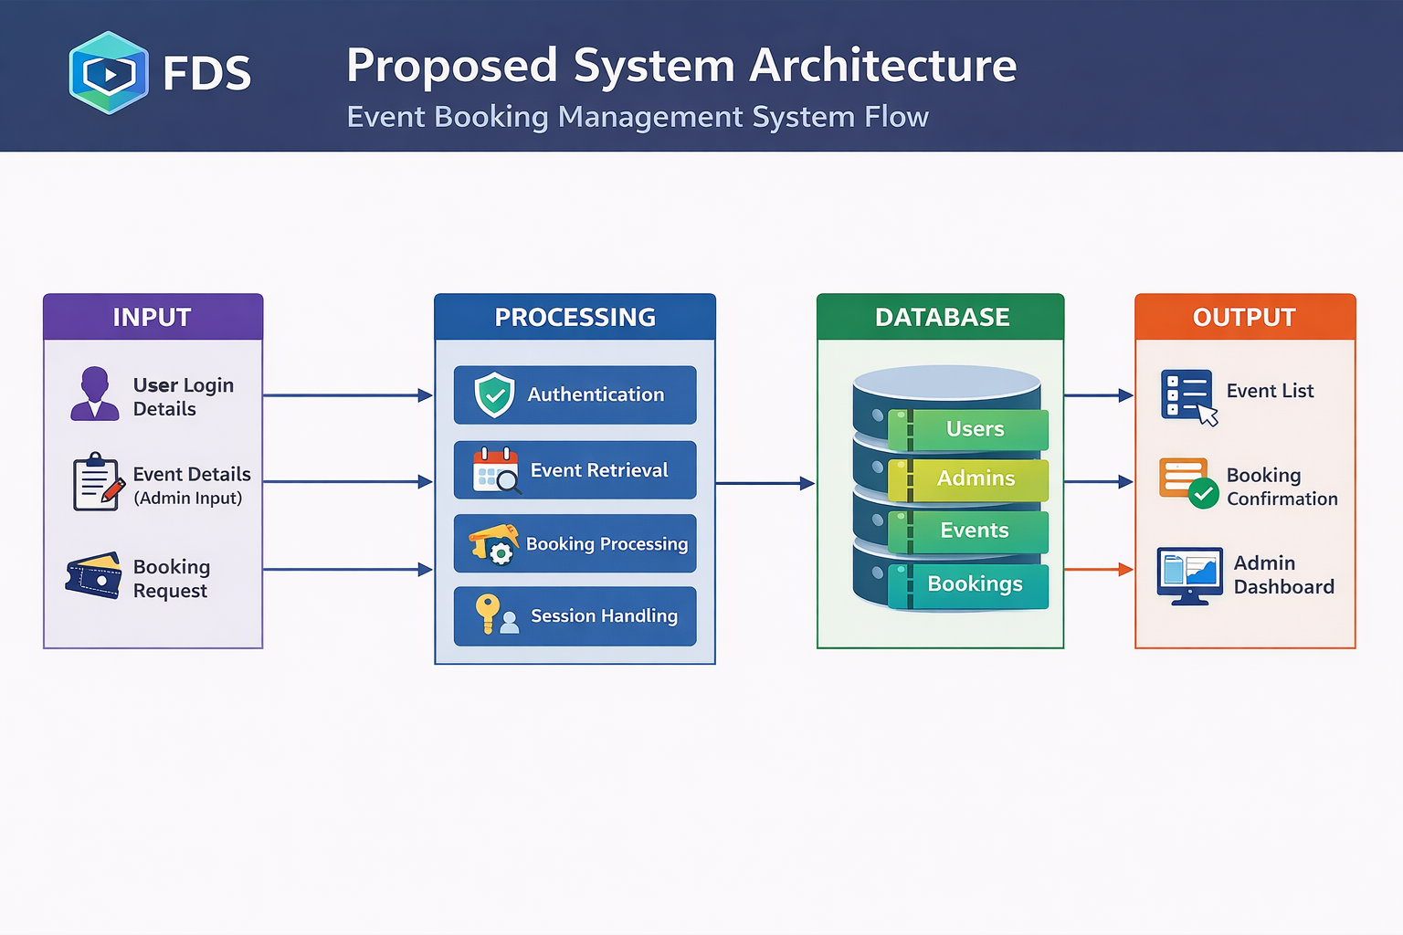
PROPOSED SYSTEM ARCHITECTURE
1
2
3
4
5
6
7
8
9

Slide 8
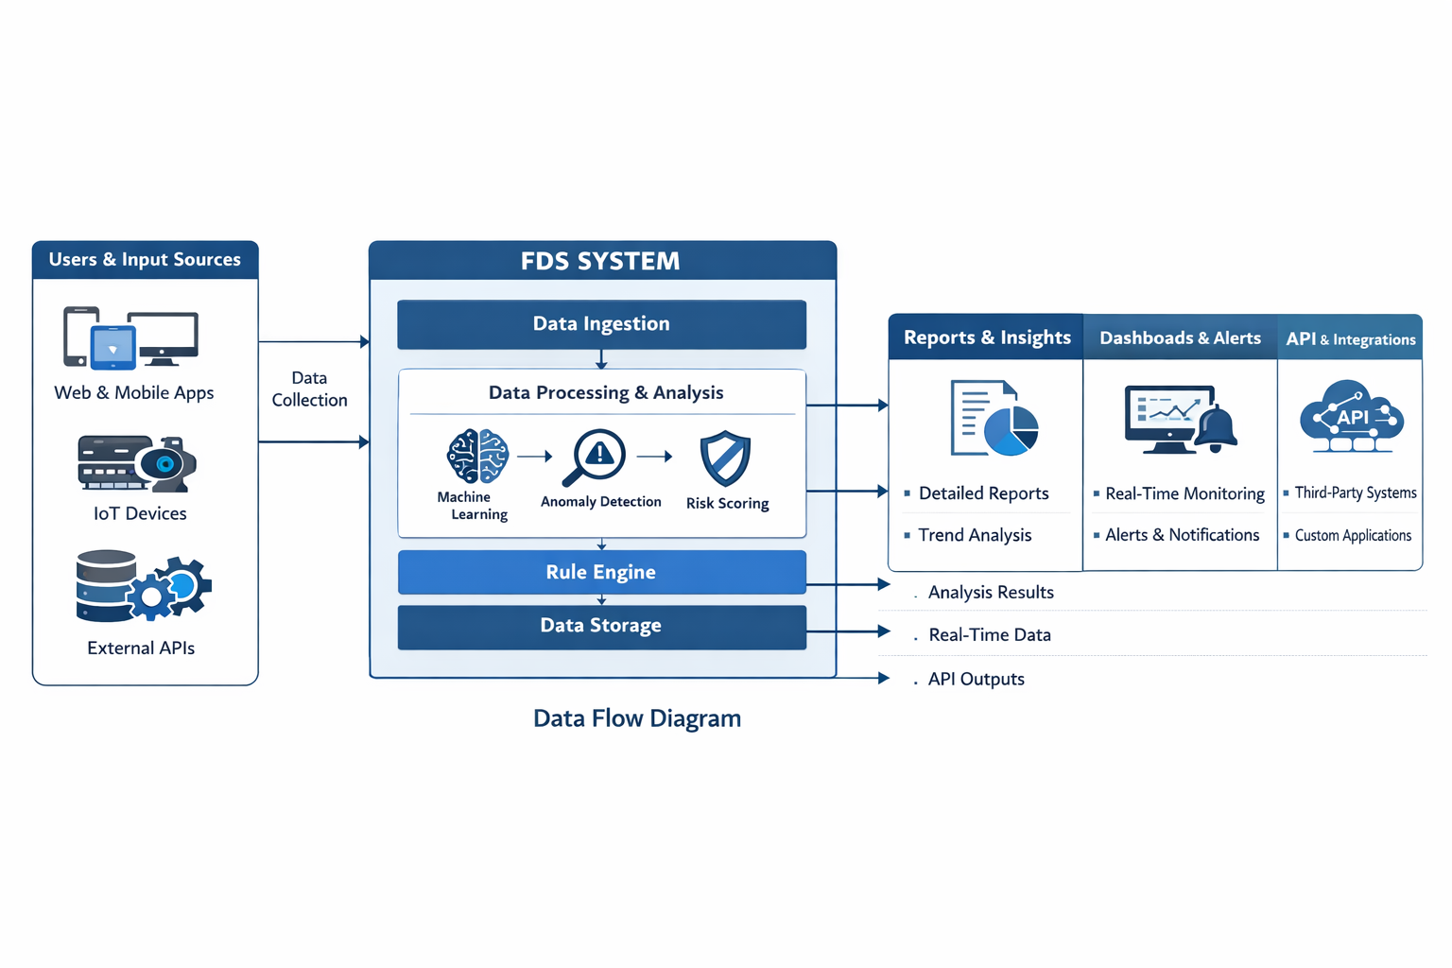
WORKFLOW
1
2
3
4
5
6
7
8
9

Slide 9
TECHNOLOGIES USED
Frontend: HTML, CSS, JavaScript
Backend: PHP
Database: MySQL
Tools: XAMPP, VS Code, phpMyAdmin
Hardware/Software: Windows OS, Web Browser, Apache Server
1
2
3
4
5
6
7
8
9

Slide 10
MODULE DESCRIPTION
Module 1: User Management
Handles user login and registration using phone/email and secure password verification.
Module 2: Event Display
Fetches and displays events dynamically from the database (Home, Live Events, Dining).
Module 3: Event Details & Booking
Shows detailed event info and allows users to book tickets.
Module 4: Booking Management
Stores user bookings and allows users to view booking history.
Module 5: Admin Management
Admin can add events, upload images, and manage system data through dashboard.
1
2
3
4
5
6
7
8
9

Slide 11
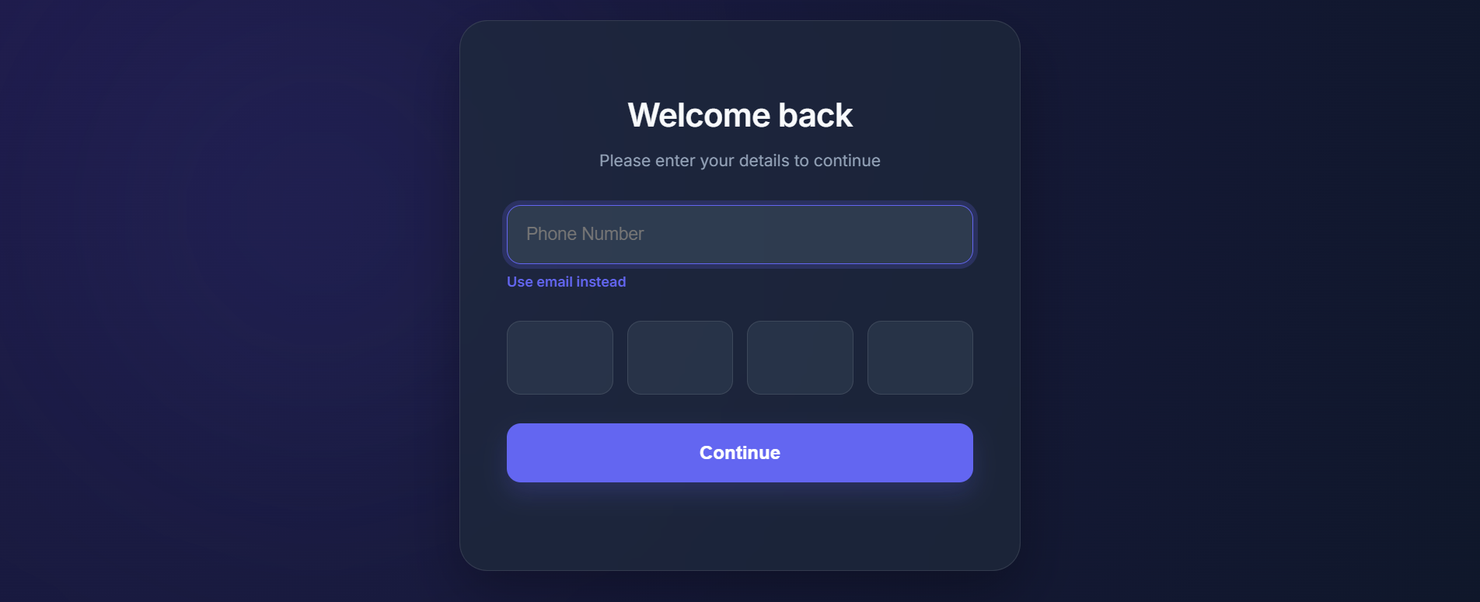
IMPLEMENTATION SCREENSHOTS
1
2
3
4
5
6
7
8
9

Slide 12
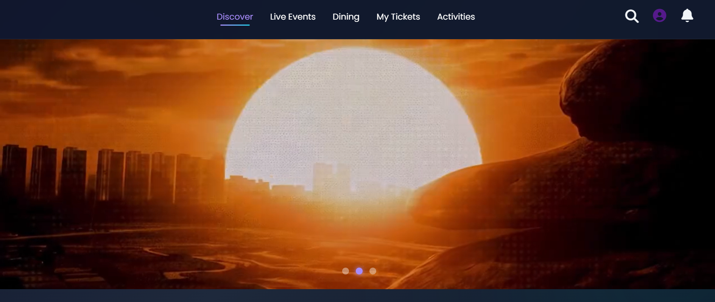
IMPLEMENTATION SCREENSHOTS
1
2
3
4
5
6
7
8(A)
9

Slide 13
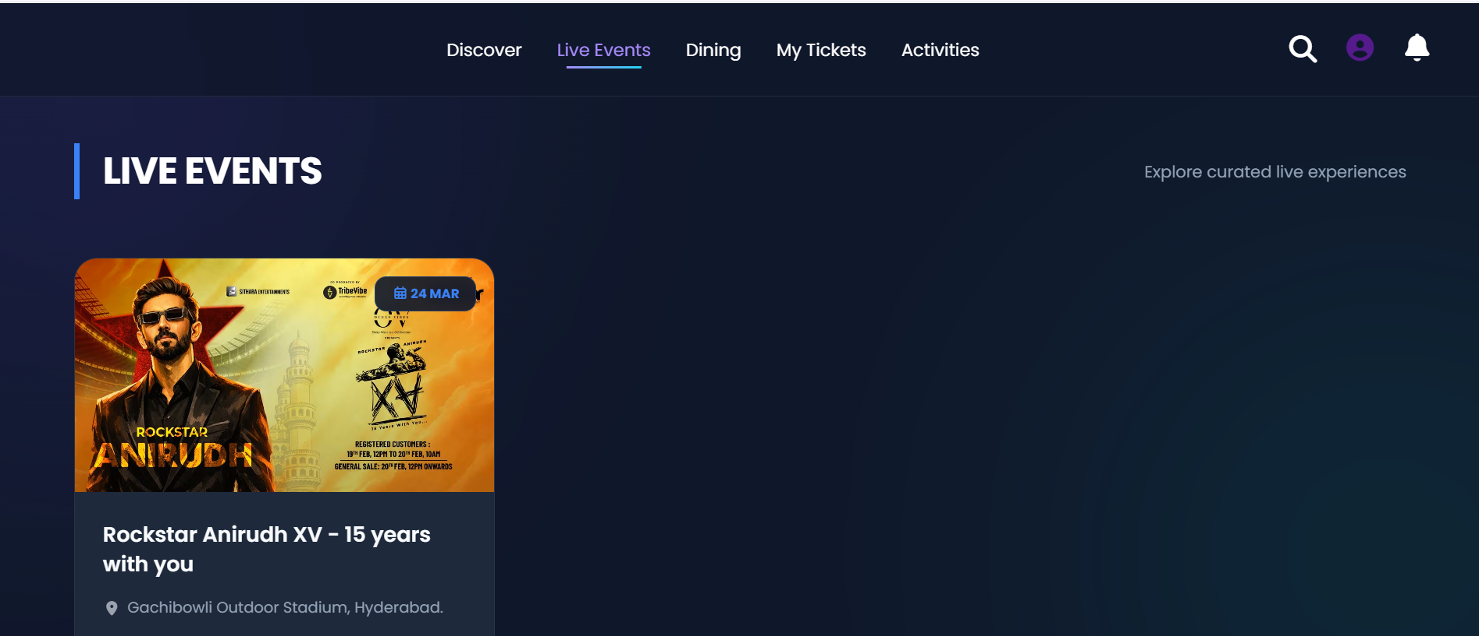
IMPLEMENTATION SCREENSHOTS
1
2
3
4
5
6
7
8(B)
9

Slide 14
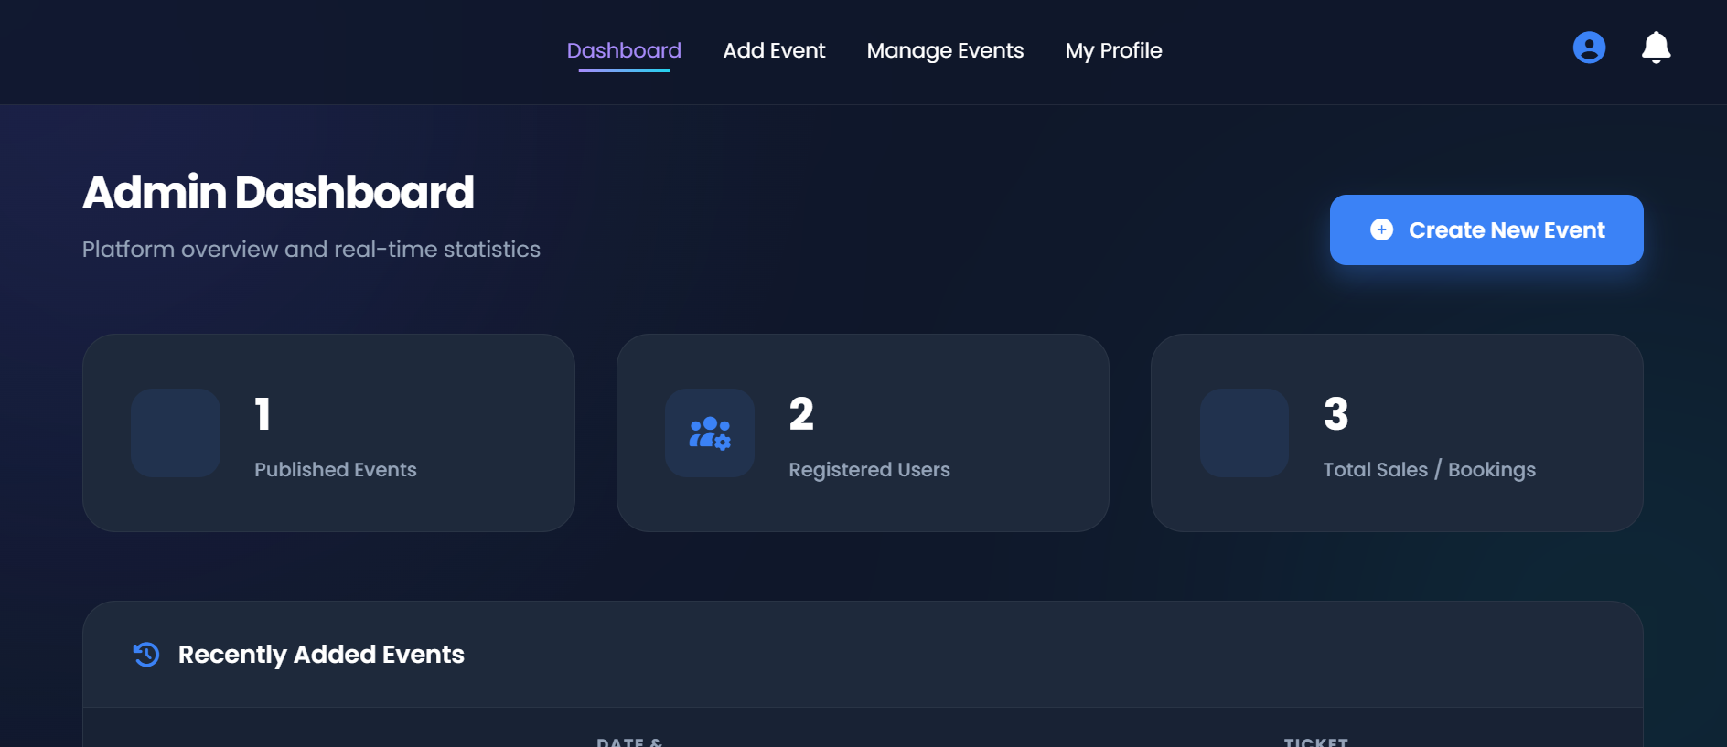
IMPLEMENTATION SCREENSHOTS
1
2
3
4
5
6
7
8(C)
9

Slide 15
ADVANTAGES & LIMITATIONS
1
Advantages:
Automated system.
User-friendly interface.
Secure authentication.
Real-time event display.
Centralized database. Limitations:
• No online payment system • Runs on localhost • No notification system
2
3
4
5
6
7
8
9

Slide 16
Thank you

